Slide 1
ENED1120: Foundations of Engineering Design Thinking II
Day 11.2
Conditional Flow in Visual Basic for Applications

Slide 2

Outline
Announcements
RAT 11.1
VBA Conditional Flow
Review of basic syntax
Example
Activity
CFU 11.1
Work on Projects

Slide 3
Announcements
See Canvas
https://uc.instructure.com/courses/1744110/discussion_topics/9731890

Slide 4




Slide 5
Syntax Summary
Conditional Statements:
Relational operators:
> greater than
< less than
>= greater than or equal to
<= less than or equal to
= equal to <> not equal to
Logical operators:
And, Or, Not
If Structure: If condition Then code ElseIf condition Then code ⁞ Else code End If

Slide 6
Example
Create a macro in Excel that will take a temperature along with the original and desired units and covert the temperature from one system of units to the other
You can do this problem using Excel formulas and would end up with something like this: =IF(C3="F",IF(D3="C",(5/9)*(B3-32),(5/9)*(B3-32)+273.15),IF(C3="C",IF(D3="F",(9/5)*B3+32,B3+273.15),IF(D3="C",B3-273.15,(9/5)*(B3-273.15)+32)))
Original | Desired | Conversion
ºF | ºC | T_{C} = (5/9)*(T_{F} – 32)
ºC | ºF | T_{F} = (9/5)*T_{C} + 32
ºF | K | T_{K} = (5/9)*(T_{F} – 32) + 273.15
ºC | K | T_{K} = T_{C} + 273.15
K | ºF | T_{F} = (9/5)*(T_{K} – 273.15) + 32
K | ºC | T_{C} = T_{K} – 273.15

Slide 7



Do not edit How to change the design
What data type should the units be taken in as?
The Slido app must be installed on every computer you’re presenting from

Slide 8
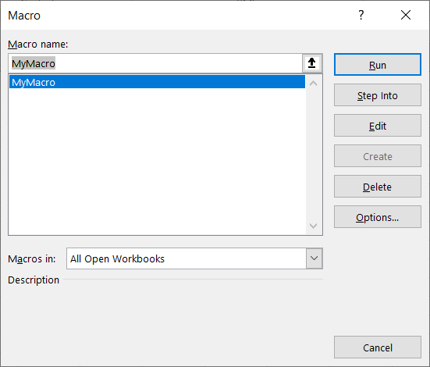
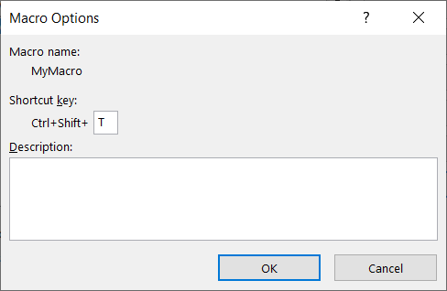
Example
A few helpful commands: ActiveCell – refers to the currently selected cell in the worksheet ActiveCell.Offset(r,c) – refers to a cell r rows and c columns away from the currently selected cell
You can assign a shortcut to a macro from the macro window

Slide 9
Do not edit How to change the design
If I'm currently on Cell 3E, which cell will ActiveCell.Offset(0, -3) point to?
The Slido app must be installed on every computer you’re presenting from

Slide 10

Example
Take 5 minutes silently to write/type out how you would build this conditional decision tree. This can (should) be pseudocode.
Then, compare your answer with your neighbor’s answer for the next 5 minutes. Discuss:
What did you all do similarly?
What did you all do differently?
Which aspects of your partner’s solution
would you use in your solution the next
time you see a similar problem?

